Slide 1
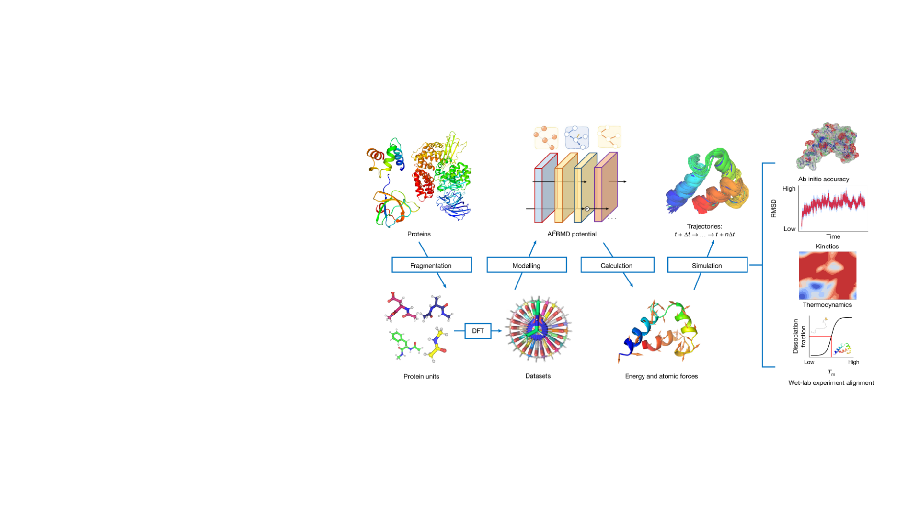
Learning protein
dynamics from
quantum fragments
Ab initio characterization of protein molecular
dynamics with AI²BMD
Tong Wang et al.
•
Nature 635, 1019–1027 (2024)
Reusable quantum-trained fragments connect
atomic forces to protein motion.
Sean Florez
•
CSCI 7000
•
September 28, 2026
Wang et al., Nature (2024), DOI: 10.1038/s41586-024-08127-z
•
Fig. 1
1

Slide 2
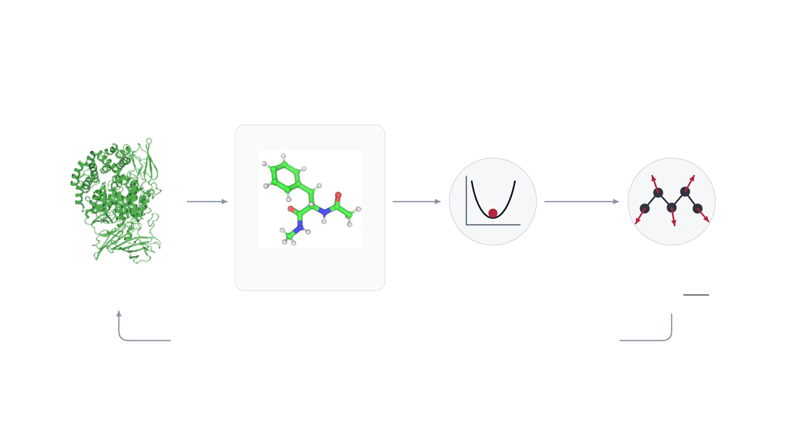
APPROACH · PROTEIN TO LOCAL UNIT
From a whole protein to fragment energies and forces
REPRESENTATIVE CAPPED UNIT
Define
local units
ViSNet
Differentiate
Coordinates
Unit energy
Force contributions
Whole protein
atom types + (x, y, z)
E
(
r
)
∂
E
Aminopeptidase N
F
=
−
i
∂
r
i
All unit terms + remaining interactions → update the whole protein
Atomic coordinates define each local environment. Combined forces update the protein’s motion.
Protein: Wang et al., Nature (2024), Fig. 2a; unit: Fig. 1
•
Workflow schematic
•
DOI: 10.1038/s41586-024-08127-z
2

Slide 3
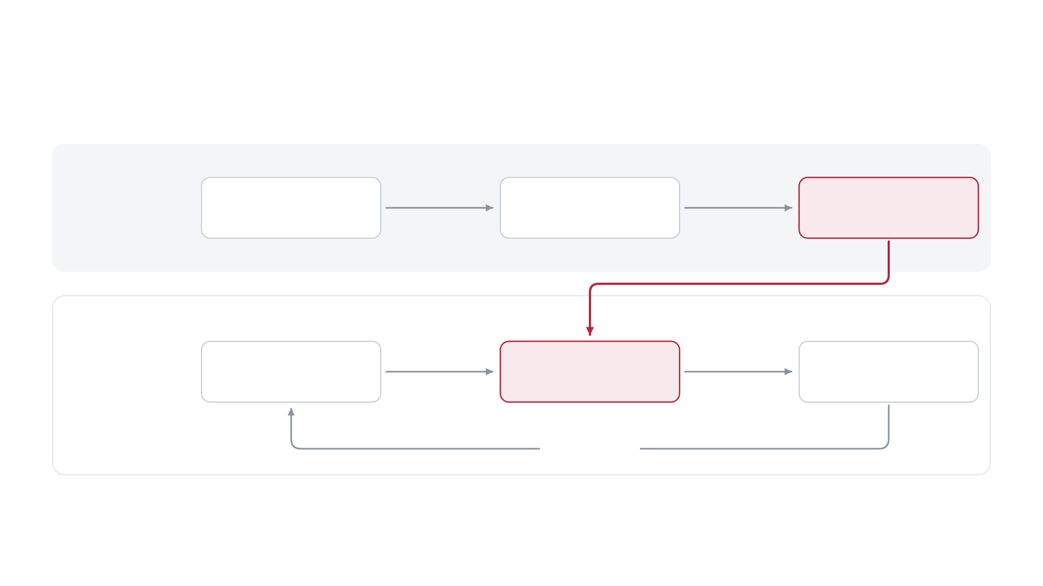
APPROACH
Reusable fragments make quantum training data tractable
Fragment
DFT labels
Trained potentials
OFFLINE
conformations
DURING
Protein fragments
Predicted energies and
Atomic motion
SIMULATION
forces
repeat each step
A fixed vocabulary of local units supports evaluation across many protein sequences.
Schematic adapted from Wang et al., Nature (2024), DOI: 10.1038/s41586-024-08127-z
•
Fig. 1
3

Slide 4

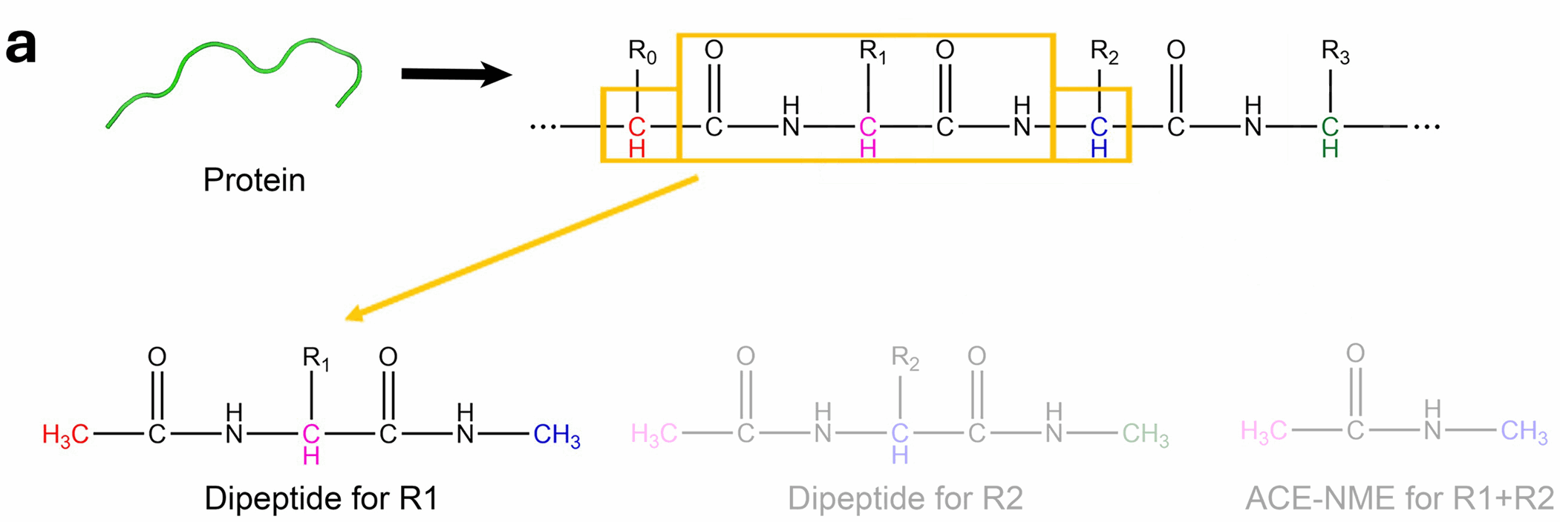
METHOD · FRAGMENTATION
Overlapping fragments reconstruct protein energy
E
≈
Σ
E
−
Σ
E
+
E
20
capped amino-acid units +
1
shared Ace–Nme unit
protein
units
overlaps
remaining interactions
Capped units
Ace–Nme overlap
Coulomb + LJ
Subtracting the shared contribution corrects double counting; additional interactions connect separate regions.
Wang et al., Nature (2024), DOI: 10.1038/s41586-024-08127-z
•
Extended Data Fig. 7
4

Slide 5
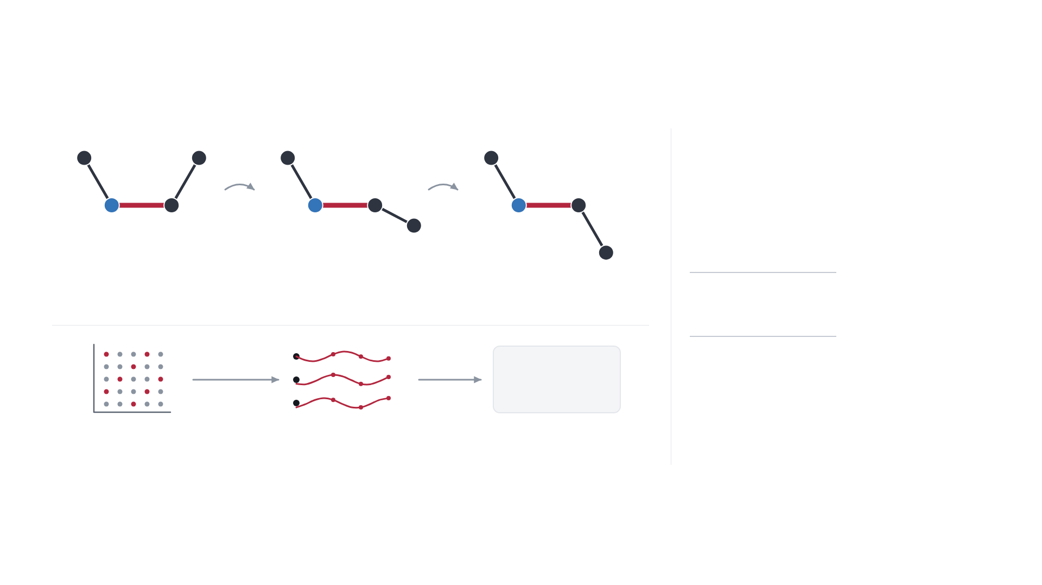
TRAINING DATA · WHAT IS A CONFORMATION?
Different conformations teach the model how energy changes
A conformation is one 3D arrangement of the same bonded atoms.
C
C
C
C
twist
twist
20
amino-acid units
C
×
5,184
starting conformations per
N
Cα
N
Cα
N
Cα
unit (72 × 72)*
C
†
×
200
snapshots per start
Conformation A
Conformation B
Conformation C
=
20,736,000
Rotating the
N–Cα bond (ϕ)
changes shape, energy and forces.
+
144,000
Ace–Nme (72 × 2,000)
20.88M
Each geometry
=
labelled examples
ψ
DFT → E, F
80% train ≈ 16.7M
ϕ
10% validation · 10% test
Angle grid
Short quantum
Energy + atomic forces
trajectories
*Two backbone angles at 5° intervals, per non-proline unit. Grid and conformations are schematic.
†Derived: 1,036,800 per unit ÷ 5,184 = 200.
Angles vary continuously. These examples sample the space of possible shapes.
Conformation and sampling schematics based on Wang et al., Nature (2024), Methods
•
DOI: 10.1038/s41586-024-08127-z
5

Slide 6
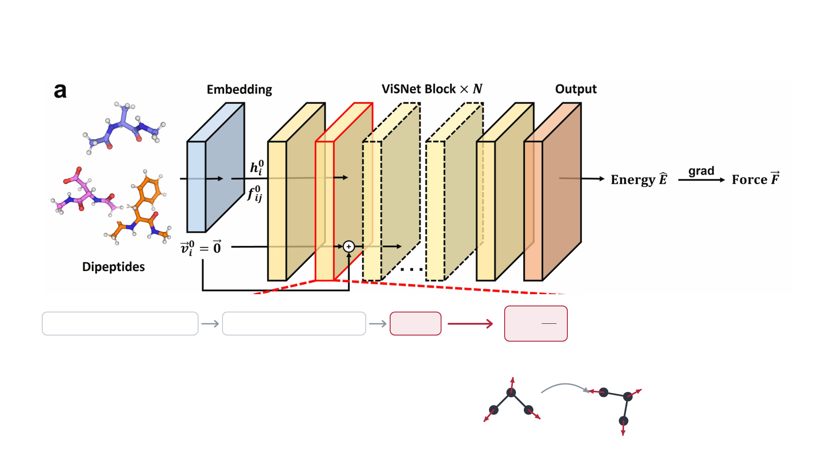
METHOD · LEARNED POTENTIAL
ViSNet learns energy and geometry-consistent forces
Atomic numbers + coordinates
Geometric message passing
Energy
F
=
−
∂
E
Forces follow the negative
∂
energy gradient.
r
Rotate the input
Energy unchanged
Rotation-aware representations and energy-derived forces encode useful
Forces rotate with the atoms
physical structure.
Explanatory schematic based on Wang et al., Nature (2024), DOI: 10.1038/s41586-024-08127-z
•
Extended Data Fig. 1
6

Slide 7
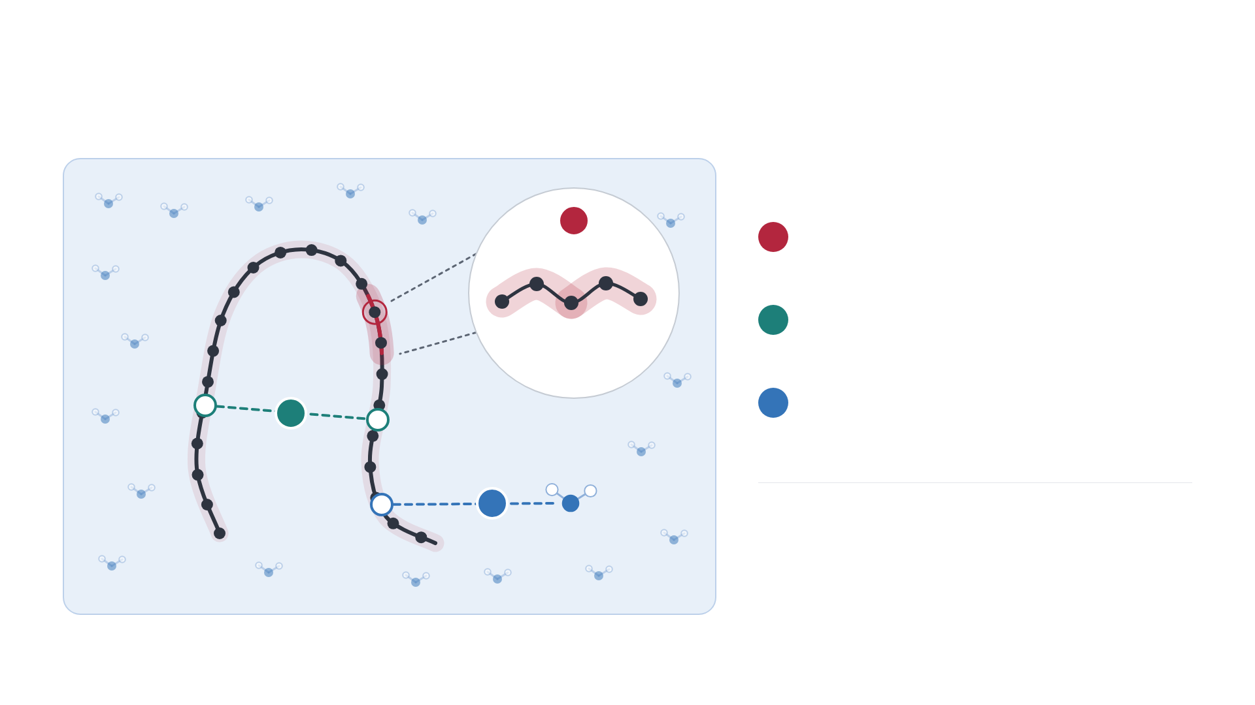
METHOD · HYBRID SYSTEM
AI²BMD combines learned terms with classical interactions
1
Local overlapping units
1
ViSNet terms + overlap correction
2
Remaining protein interactions
Coulomb + Lennard-Jones terms
Overlapping units
3
Solvent and coupling
2
AMOEBA polarizable force field
3
Reported simulation results describe this combined
system.
Protein backbone · schematic
Hybrid-system schematic based on Wang et al., Nature (2024), DOI: 10.1038/s41586-024-08127-z
•
Methods
7

Slide 8
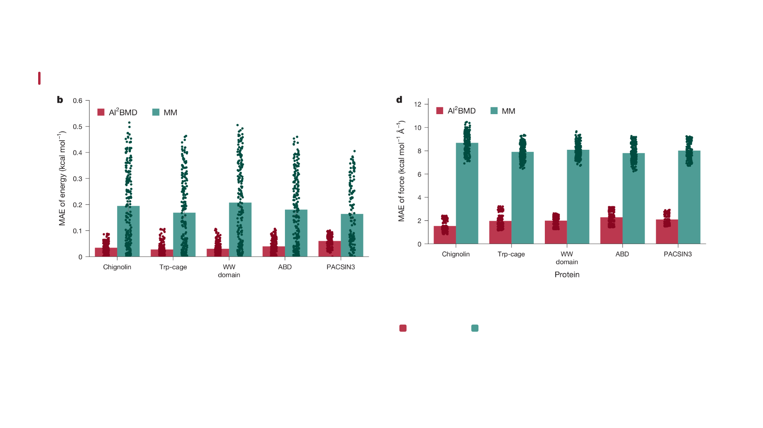
EVIDENCE · ERROR AGAINST DFT
Protein benchmarks show lower error against DFT
5 smaller proteins
: whole-protein DFT reference
AI²BMD MEAN ENERGY MAE
MEAN FORCE MAE
0.038
1.974
8.094
kcal mol⁻¹ atom⁻¹
AI²BMD
MM
kcal mol⁻¹ Å⁻¹
4 larger proteins use a fragmented DFT reference. Nine proteins, 175–13,728 atoms; 200 configurations each.
Wang et al., Nature (2024), DOI: 10.1038/s41586-024-08127-z
•
Fig. 2b,d
8

Slide 9
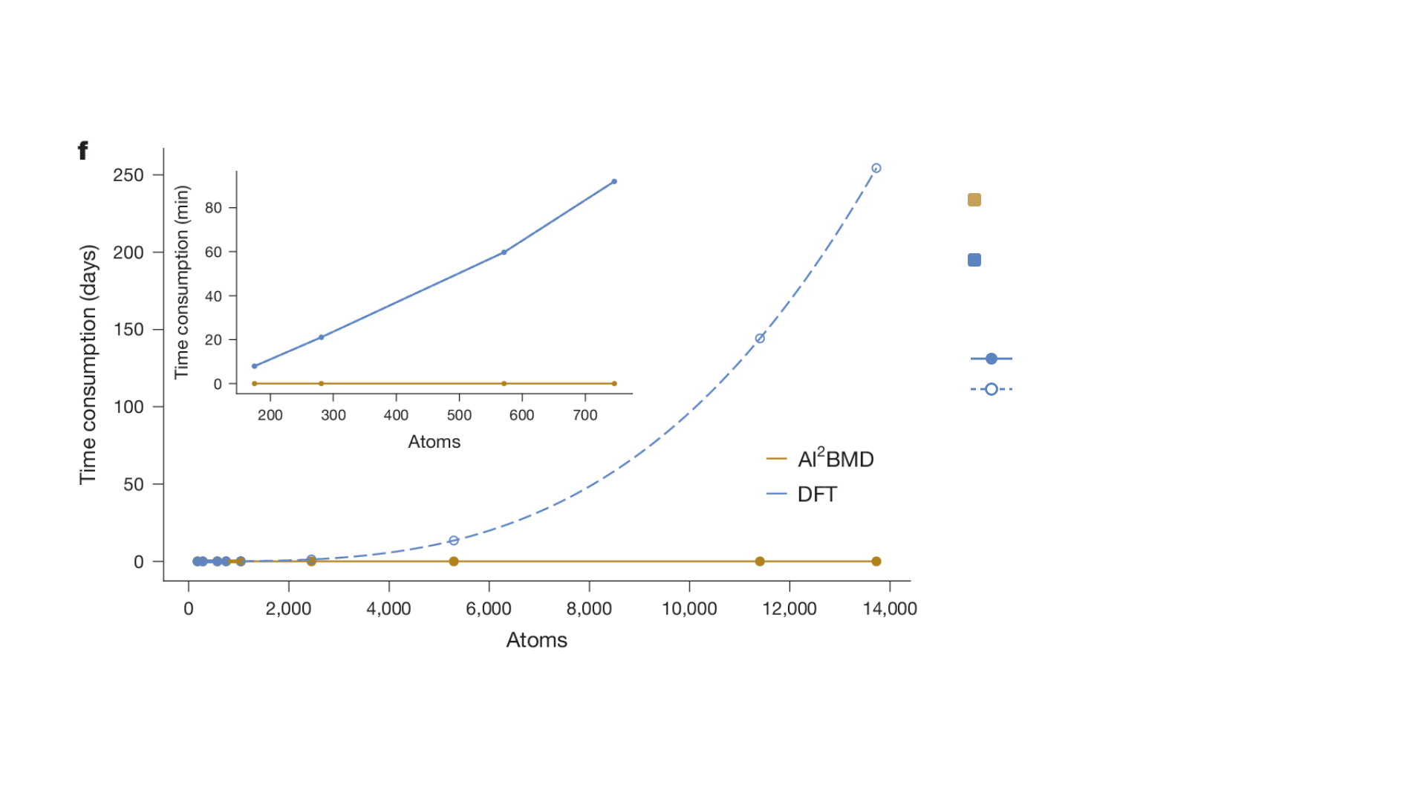
EVIDENCE · RUNTIME
Energy evaluation is much faster than DFT
TRP-CAGE, 281 ATOMS
0.072 s
AI²BMD
21 min
DFT
Reported system: NVIDIA A6000 + 32 CPU cores
Measured
· DFT, first four proteins
Extrapolated
· DFT, last five proteins
Large-protein DFT timings are extrapolated.
These measurements concern energy evaluation;
full solvated trajectories add further work.
Wang et al., Nature (2024), DOI: 10.1038/s41586-024-08127-z
•
Fig. 2f
9

Slide 10
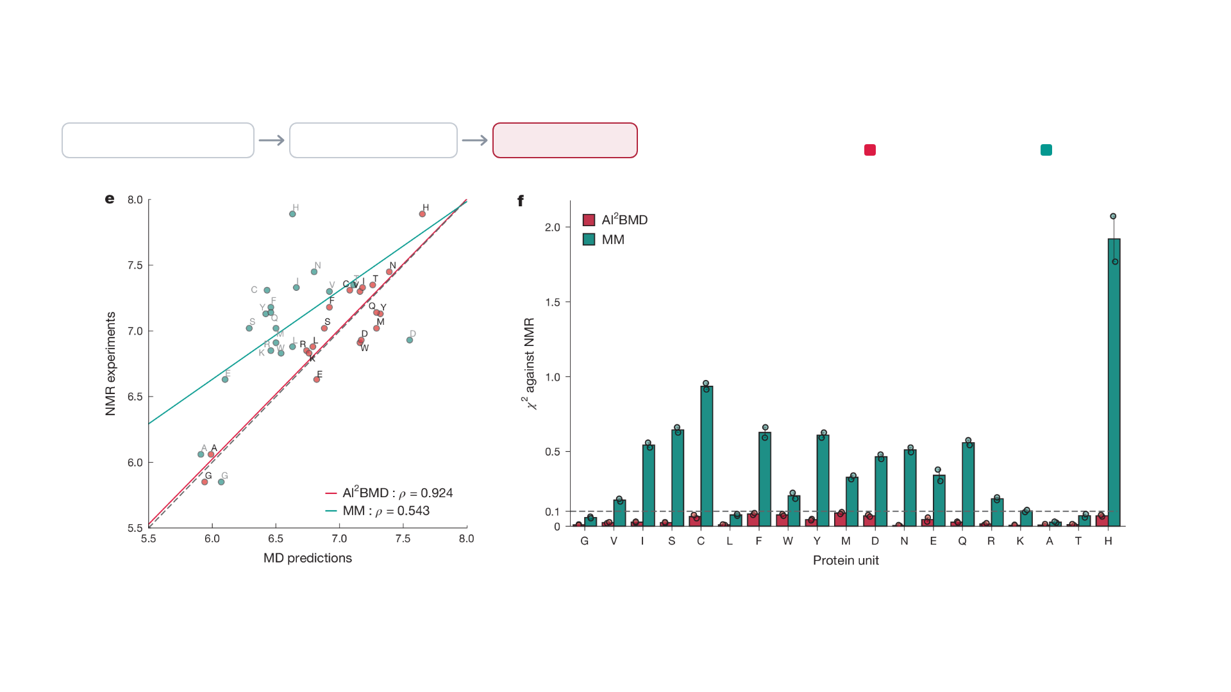
EVIDENCE · EXPERIMENT
NMR observables test sampled conformations against experiment
PEARSON CORRELATION
Backbone-angle samples
Predicted J couplings
NMR comparison
0.924
0.543
AI²BMD
MM
J couplings (Hz)
χ² error (dimensionless)
A measured observable checks one physical consequence of the simulated ensemble.
Wang et al., Nature (2024), DOI: 10.1038/s41586-024-08127-z
•
Fig. 3e,f
10

Slide 11
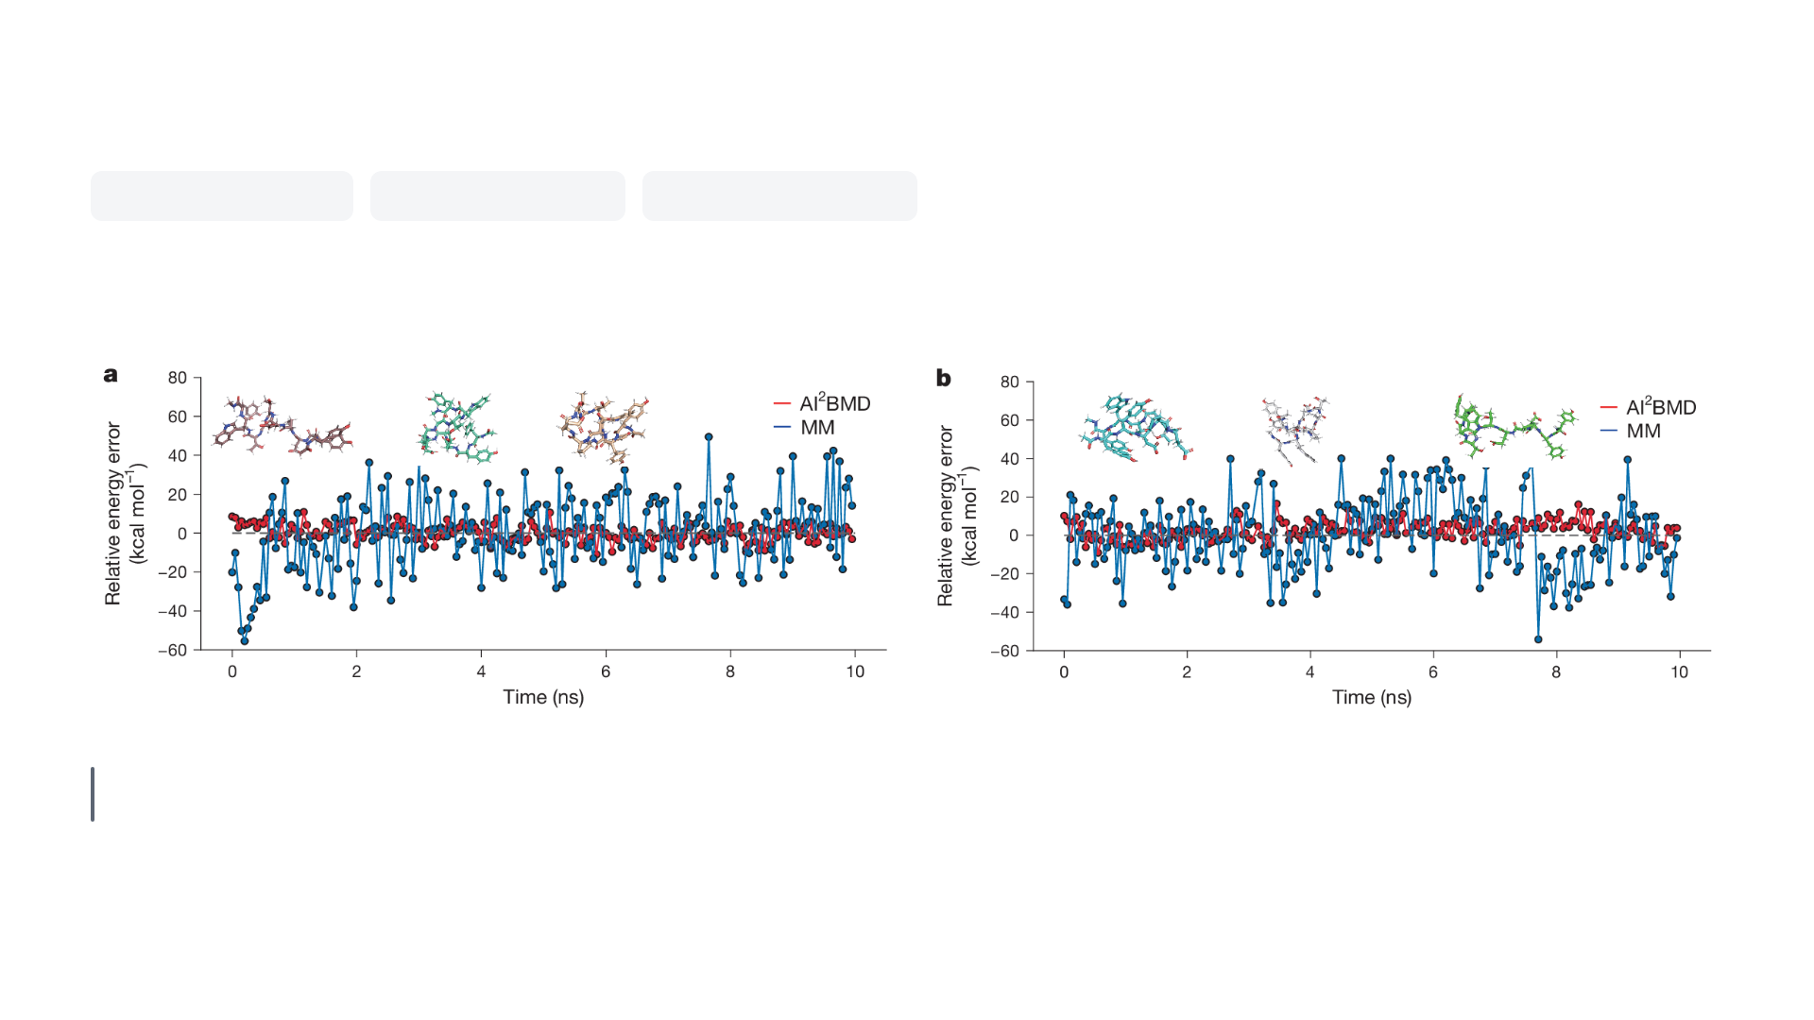
EVIDENCE · TRAJECTORIES
Short chignolin trajectories capture folding and unfolding
Chignolin
10 residues
60 starting structures
Trajectories up to 10 ns
Starts unfolded
Starts folded
Plotted curves
· Relative potential-energy error over time, against a QM protein
Selected trajectories show transitions between folded and unfolded
+ AMOEBA solvent reference
conformations.
Wang et al., Nature (2024), DOI: 10.1038/s41586-024-08127-z
•
Fig. 4a,b
11

Slide 12
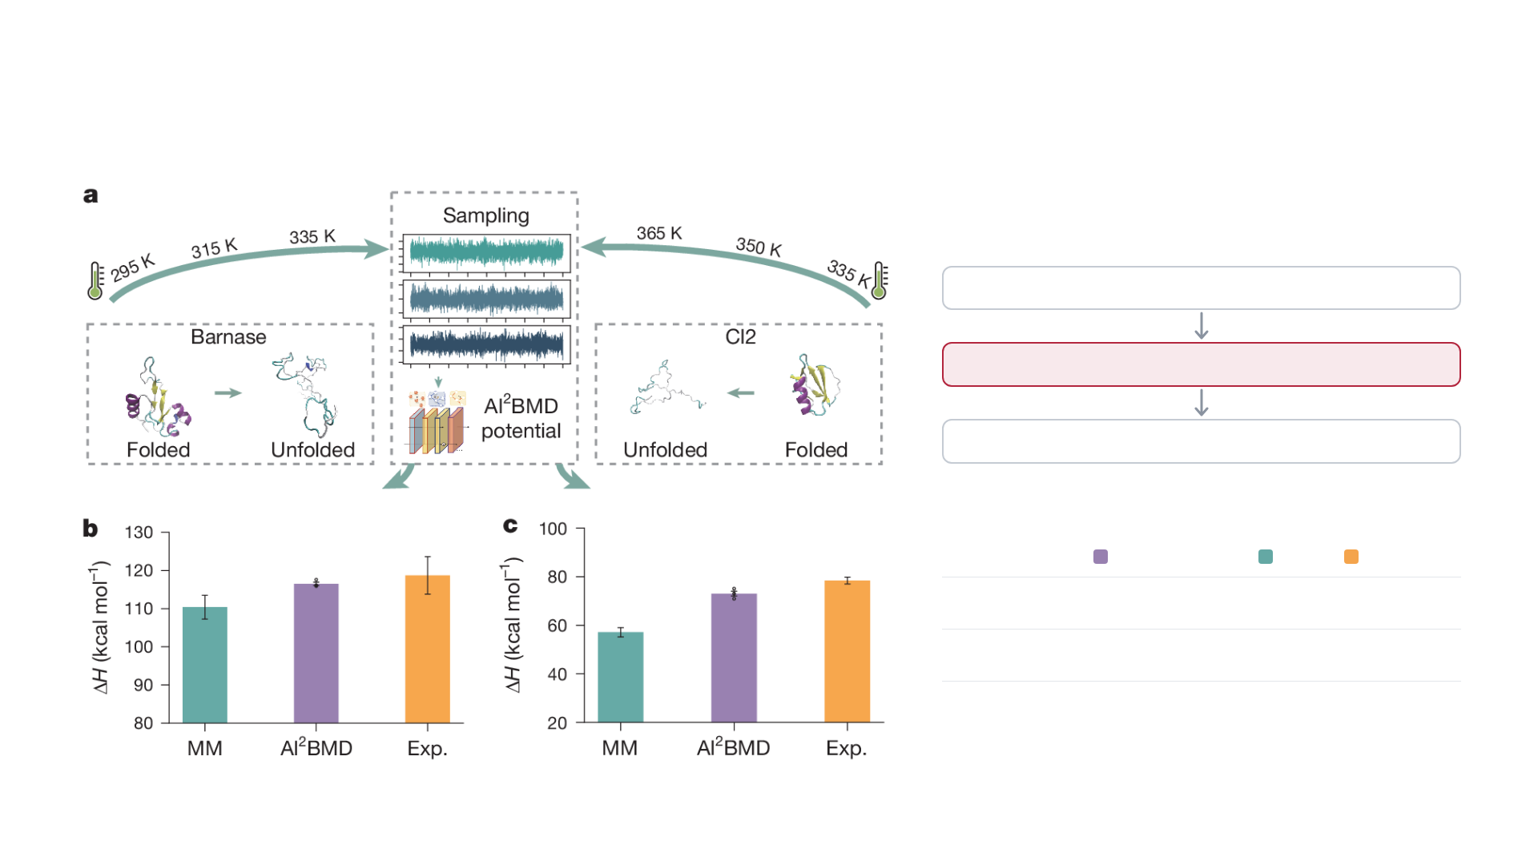
EVIDENCE · THERMODYNAMICS
Energy re-evaluation improves selected thermodynamic estimates
Classical sampling
AI²BMD energy evaluation
Thermodynamic estimates
Unfolding enthalpy ΔH
(kcal mol⁻¹)
AI²BMD
MM
EXPERIMENT
Barnase
116.5
110.4
118.7
CI2
73.0
57.1
78.4
Wang et al., Nature (2024), DOI: 10.1038/s41586-024-08127-z
•
Fig. 5a–c
12

Slide 13
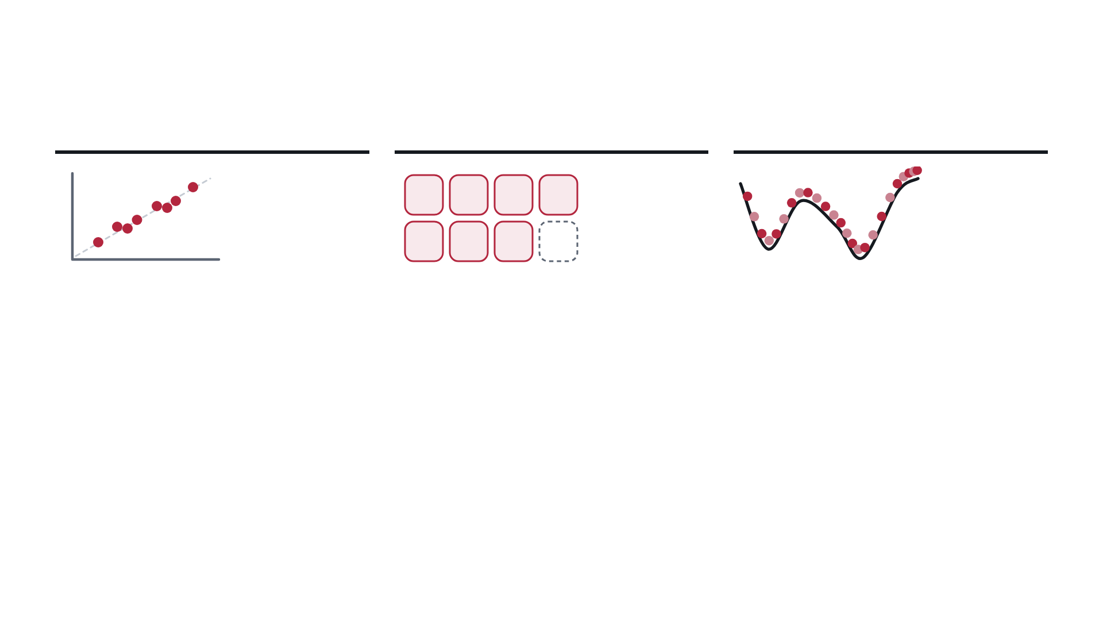
ASSESSMENT
Accuracy depends on chemistry, sampling and the reference model
?
Reference
Chemistry
Sampling
Learned DFT targets + fragmentation + hybrid
A defined vocabulary of protein units
Ensembles must cover states relevant to the
interactions
observable
DEMONSTRATED
DEMONSTRATED
DEMONSTRATED
Force MAE 1.974 (AI²BMD) and 8.094 (MM)
20 amino-acid units plus Ace–Nme cover the
Chignolin folding and unfolding in trajectories up to
kcal mol⁻¹ Å⁻¹ against whole-protein DFT
proteins tested
10 ns
CONDITION FOR REUSE
CONDITION FOR REUSE
CONDITION FOR REUSE
Agreement measures fidelity to this reference
Ligands, nonstandard residues, charge states or
Converged ensembles for each property of interest
system
reactions need new validation
Each new application needs validation at these three levels.
Assessment and schematics based on Wang et al., Nature (2024), DOI: 10.1038/s41586-024-08127-z
13

Slide 14
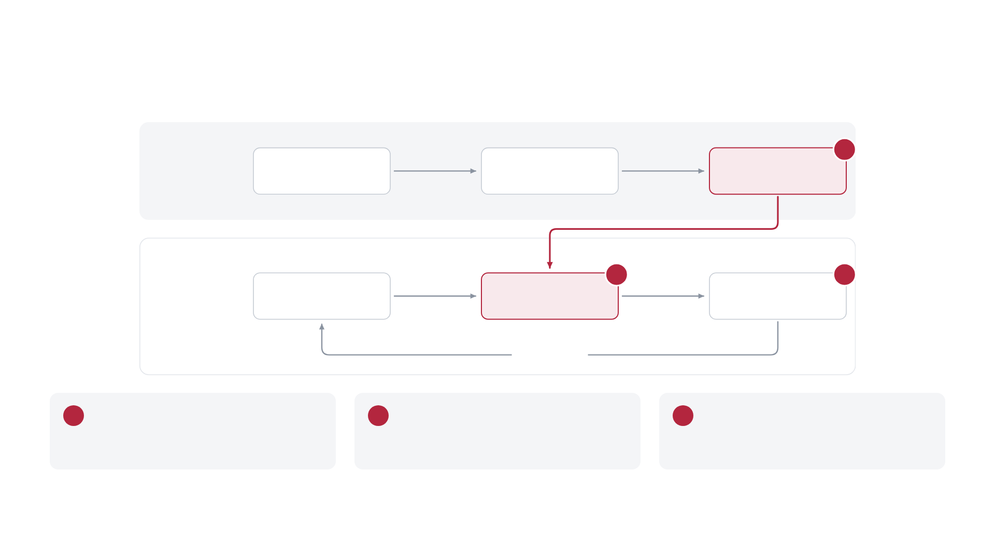
TAKEAWAYS
Reusable learned physics still needs experimental checks
1
OFFLINE
Fragment
DFT labels
Trained potentials
conformations
2
3
DURING
Protein fragments
Predicted energies and
Atomic motion
SIMULATION
forces
repeat each step
1
Reuse
2
Physical structure
3
Evaluation
Train local units, compose larger systems
Geometry and energy-derived forces
Reference errors, trajectories and
experimental observables
My takeaway:
trustworthy reuse depends on the full model-and-sampling system.
Synthesis and schematic based on Wang et al., Nature (2024), DOI: 10.1038/s41586-024-08127-z
14

Slide 15

Thank you
OFFLINE
Fragment
DFT labels
Trained potentials
Questions?
conformations
Ab initio characterization of protein molecular
DURING
Protein fragments
Predicted energies and
Atomic motion
dynamics with AI²BMD
SIMULATION
forces
Tong Wang et al.
•
Nature 635, 1019–1027 (2024)
repeat each step
Sean Florez
•
CSCI 7000
Schematic adapted from Wang et al., Nature (2024), DOI: 10.1038/s41586-024-08127-z
•
Fig. 1
15

Slide 16
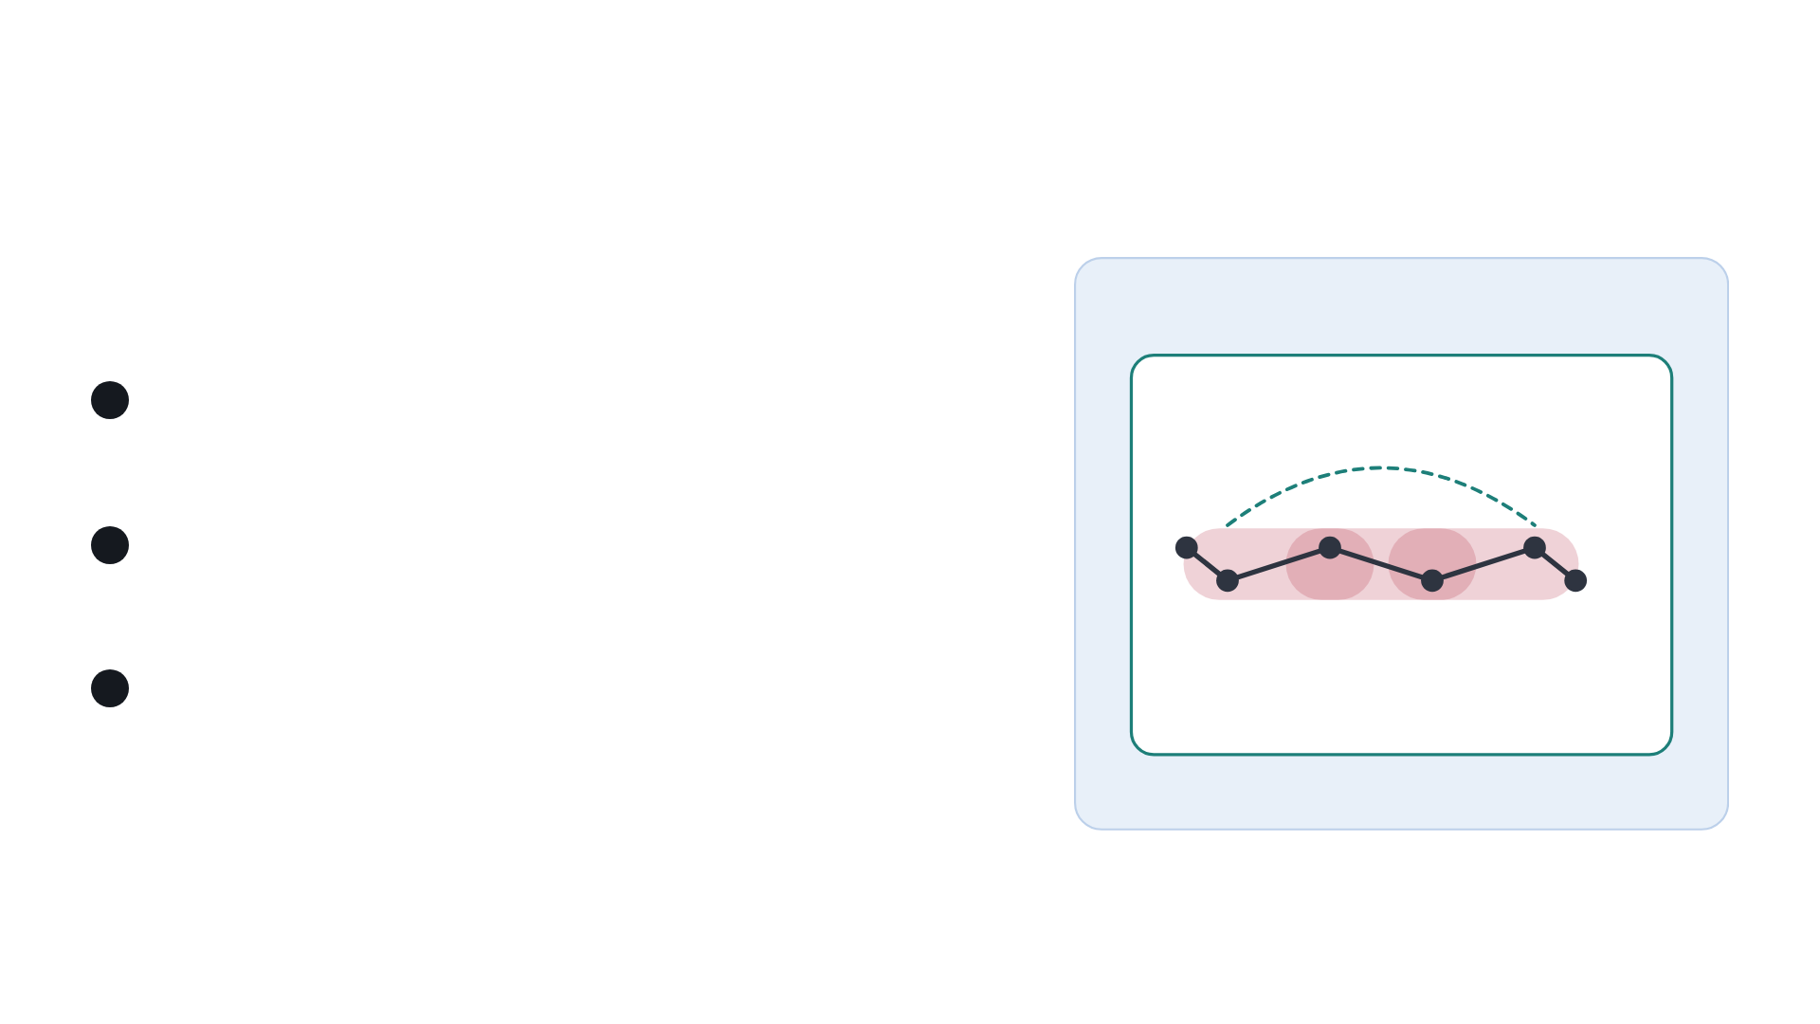
BACKUP B1 · FRAGMENTATION AND HYBRID
Fragment and solvent contributions form the hybrid potential
AMOEBA
UNITS
1
E
=
Σ
E
−
Σ
E
Coulomb + LJ
units
dipeptide
Ace–Nme
PROTEIN
2
E
=
E
+
E
+
E
protein
units
remaining Coulomb
remaining LJ
TOTAL SYSTEM
ViSNet units
3
E
=
E
+
E
−
E
total
protein
AMOEBA,all
AMOEBA,protein
Subtract overlapping/internal contributions to avoid double counting.
Equations and schematic based on Wang et al., Nature (2024), DOI: 10.1038/s41586-024-08127-z
•
Methods; Extended Data Fig. 7
16

Slide 17
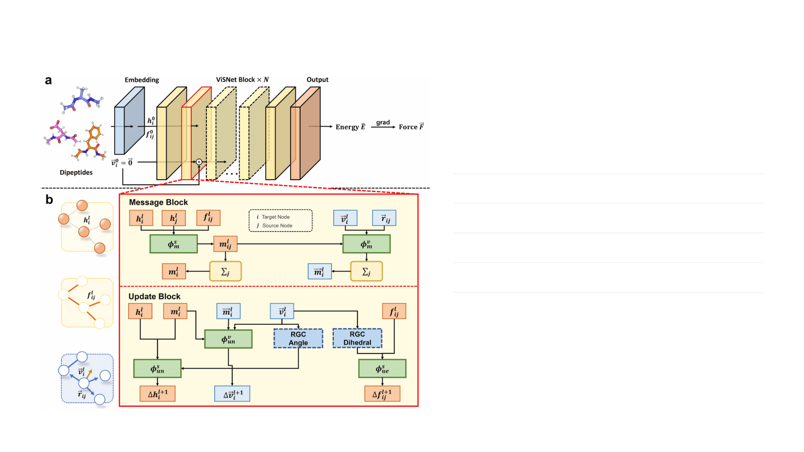
BACKUP B2 · NETWORK
Training combines energy and force supervision
Separate ViSNet potential for each of
21
unit types
6
hidden layers •
128
-dimensional embeddings
5
Å cutoff • maximum
32
neighbours
Energy / force loss weights:
0.05
/
0.95
Random per-unit train / validation / test split:
80
/
10
/
10
Wang et al., Nature (2024), DOI: 10.1038/s41586-024-08127-z
•
Extended Data Fig. 1; Methods
17

Slide 18
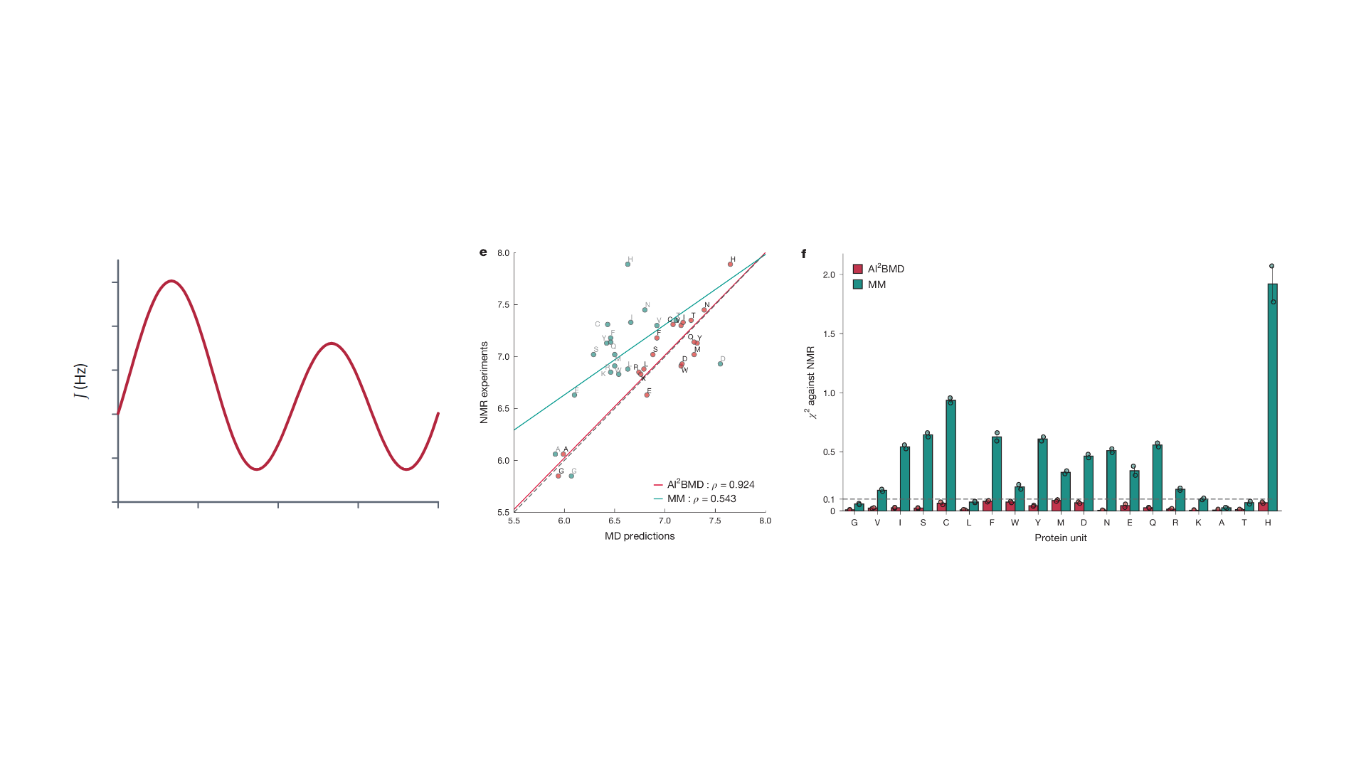
BACKUP B3 · NMR
Backbone angles determine predicted NMR couplings
J
(
ϕ
)
=
7.09
cos
²(
ϕ
−
60°)
−
1.42
cos
(
ϕ
−
60°)
+
1.55
10
8
6
4
2
0
−180°
−90°
0°
90°
180°
ϕ
Curve plotted from the equation above
Correlation and χ² errors provide complementary views of agreement.
Average J over sampled backbone conformations.
J is measured in Hz; ϕ is a backbone dihedral angle.
Wang et al., Nature (2024), DOI: 10.1038/s41586-024-08127-z
•
Eq. 13; Fig. 3e,f
18

Slide 19
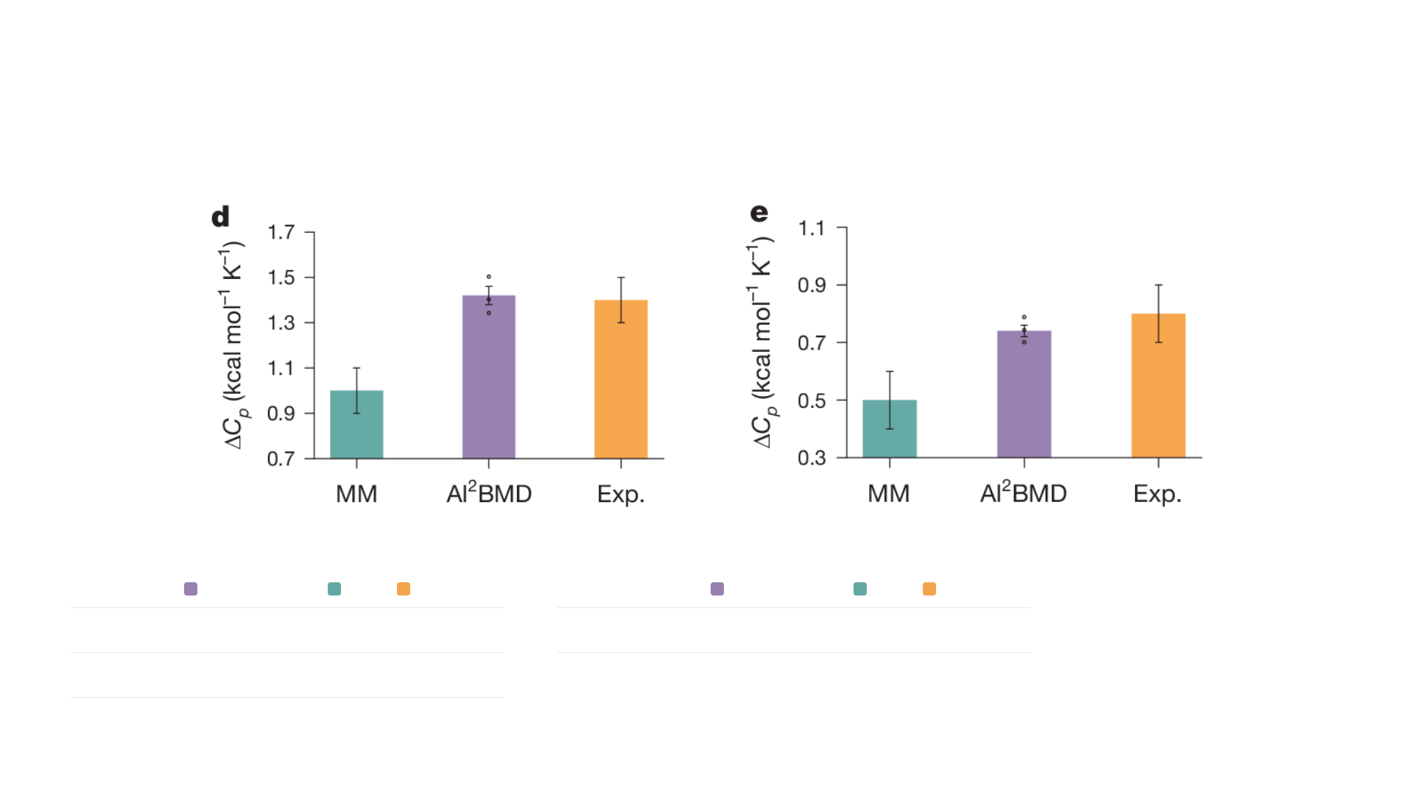
BACKUP B4 · THERMODYNAMICS
Thermodynamic comparisons depend on ensembles and targets
Barnase
CI2
ΔC
(kcal mol⁻¹ K⁻¹)
WW-domain T
p
m
AI²BMD
MM
EXPERIMENT
AI²BMD
MM
EXPERIMENT
WW-domain improvement leaves
Barnase
1.4
1.0
1.4
WW domain
359.06 K
353.69 K
371 ± 2 K
about 12 K discrepancy.
CI2
0.7
0.5
0.8
Wang et al., Nature (2024), DOI: 10.1038/s41586-024-08127-z
•
Fig. 5d,e; main-text Tm values
19

Slide 20
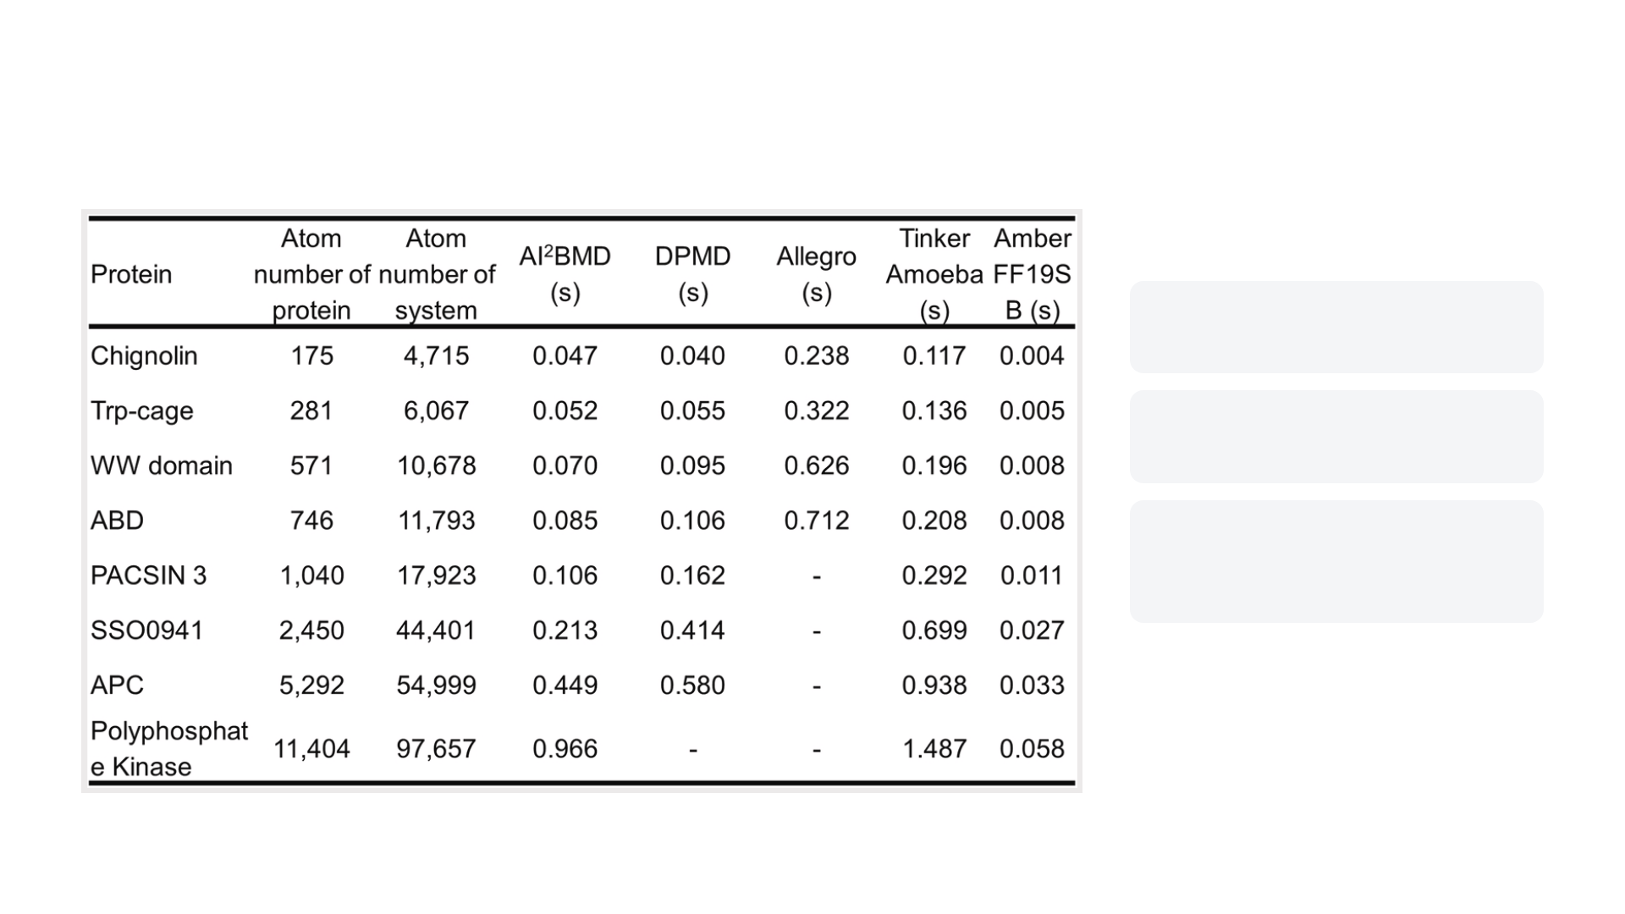
BACKUP B5 · RUNTIME AND SCOPE
Runtime and chemical coverage define practical use
ENERGY TIMING
Fig. 2f
SOLVATED PER-STEP TIMING
Extended Data Table 1
DEMONSTRATED CHEMISTRY
Protein-unit vocabulary and
specified interactions
New chemistry and rare events require
additional validation.
Wang et al., Nature (2024), DOI: 10.1038/s41586-024-08127-z
•
Fig. 2f; Extended Data Table 1
20

Slide 21
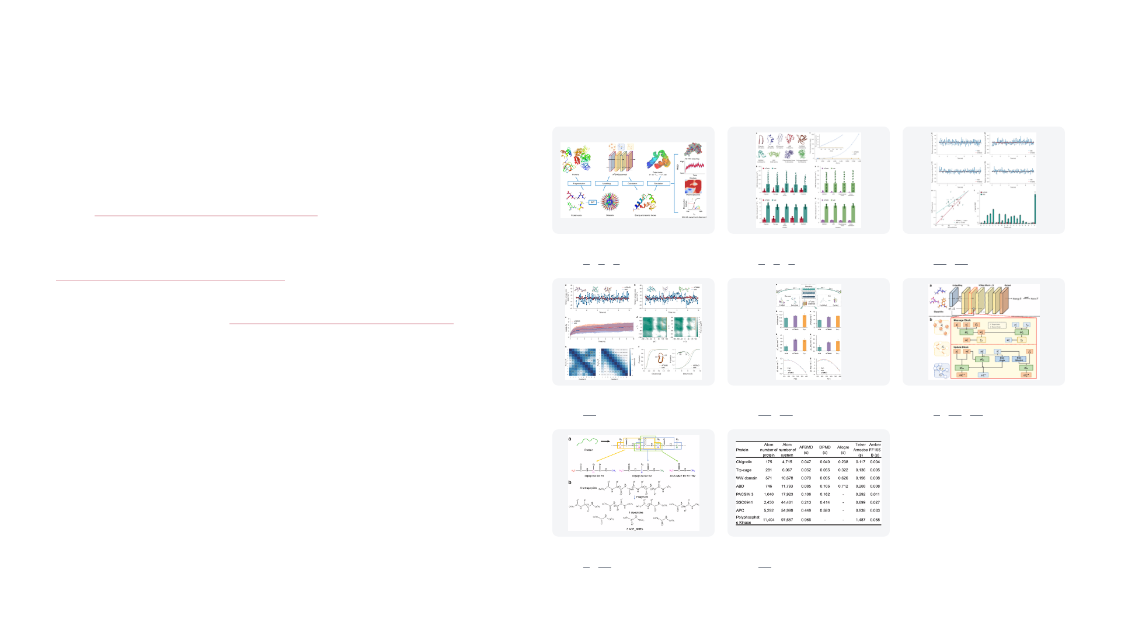
BACKUP B6 · REFERENCES
Sources and reading
PAPER AND CODE
FIGURES IN THIS DECK
Wang et al. (2024). Ab initio characterization of protein
molecular dynamics with AI²BMD. Nature 635, 1019–1027.
DOI:
10.1038/s41586-024-08127-z
Author Correction (2025). DOI:
Fig. 1
Fig. 2
Fig. 3
pages
1
·
2
·
3
pages
2
·
8
·
10.1038/s41586-024-08556-w
9
pages
10
·
18
Authors' code and data:
github.com/microsoft/AI2BMD
Fig. 4
Fig. 5
Extended Data Fig. 1
pages
11
pages
12
·
19
pages
6
·
17
·
23
Extended Data Fig. 7
Extended Data Table 1
pages
4
·
16
pages
20
Wang et al. (2024); Author Correction (2025)
21

Slide 22

SUPPLEMENTARY
Supplementary slides
23
ViSNet architecture: graph, embedding, message-passing layers, output
Backups B1 to B6 are pages 16 to 21.
Supplementary material based on Wang et al., Nature (2024), DOI: 10.1038/s41586-024-08127-z
22

Slide 23
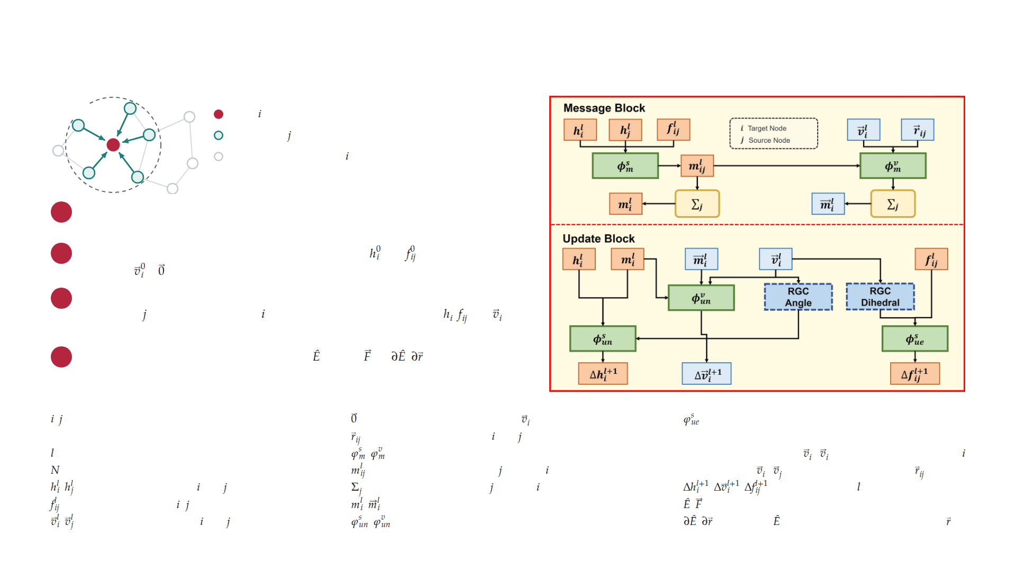
SUPPLEMENTARY S1 · VISNET ARCHITECTURE
ViSNet is a message-passing graph network over nearby atoms
5 Å
j
Atom
Neighbours
send messages
i
Beyond 5 Å: no edge to
Schematic. Grey lines: edges between other atoms.
1
Graph.
Atoms are nodes. Edges join atoms within 5 Å, at most 32 neighbours per
atom. Each unit has 12 to 36 atoms.
2
Embedding.
Atomic numbers and 3D coordinates give
and
, 128 dimensions
each, and
=
. Higher-order spherical harmonics expand the coordinates.
3
ViSNet block × N.
One message-passing layer, shown at right. Messages from
neighbours
are summed at atom
; the update block then refreshes
,
and
using angle and dihedral terms (RGC). The paper reports 6 hidden layers.
4
Output.
The output block gives one energy
. Forces
= −
/
are its gradient
with respect to the input coordinates. One model for each of the 21 unit types.
SYMBOLS IN THE FIGURE AND STEPS
,
target atom and neighbour (source) atom
zero vector, the starting value of
learned update function for edge features
Å
ångström, 0.1 nm
relative position of atoms
and
RGC
runtime geometry calculation
layer index; layer 0 is the embedding output
,
learned scalar and vector message functions
RGC-Angle
dot product
·
, angle information at atom
number of stacked ViSNet blocks
scalar message from atom
to atom
RGC-Dihedral
·
after removing parts along
,
scalar features of atoms
and
sum over the neighbours
of atom
,
,
updates for layer
+ 1
scalar features of edge
–
,
summed scalar and vector messages
,
predicted energy and forces
,
vector features of atoms
and
,
learned update functions for atom features
/
gradient of
with respect to atom coordinates
Wang et al., Nature (2024), DOI: 10.1038/s41586-024-08127-z
•
Extended Data Fig. 1b; Methods, equations 5–9
•
Graph drawing is a schematic
23

